Slide 1

DATABASE
DESIGN ON
HOSTEL
SQL

Slide 2
Introduction:-
A Girls' Hostel Management System is designed to efficiently manage hostel-related activities such as room allocation, student records, fee payments and attendance tracking. Managing a hostel manually can be challenging, leading to errors in record-keeping and inefficiencies in operations. This project aims to create a database-driven system using SQL to streamline hostel administration, improve transparency, and ensure smooth operations.
Student Registration & Room Allocation:-Store student details and assign rooms efficiently.
Fee Management:-Track payments, dues, and generate reports.
Rooms availability:-occupancy and remaining available rooms

Slide 3
Key features:-
Student Information Storage (Name, Age, Contact, Room Number, Admission Date).
Room Availability & Allocation (Room Type, Capacity, Status).
Payment & Due Management (Fees Paid, Pending Amounts).
Hostel Attendance System (Daily Check-in/Check-out Records).

Slide 4
Database:-
1. Hostel Table
This table holds general information about the hostel.
2. Students Table
This table holds student details, who stay in the hostel.
3. Rooms Table
This table holds information about rooms in the hostel.
4. Room Assignments Table
This table connects students to their assigned rooms.
5. Payments Table
This table could track payments made by students for the hostel stay.

Slide 5
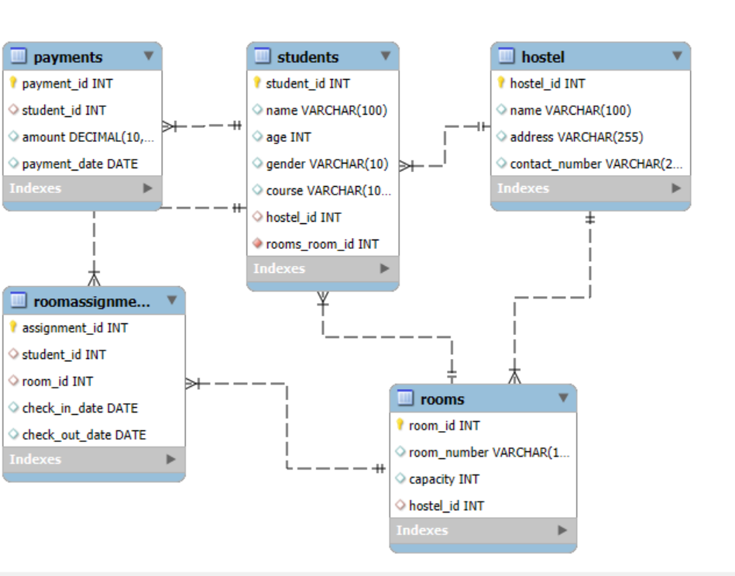
Er diagram:-

Slide 6
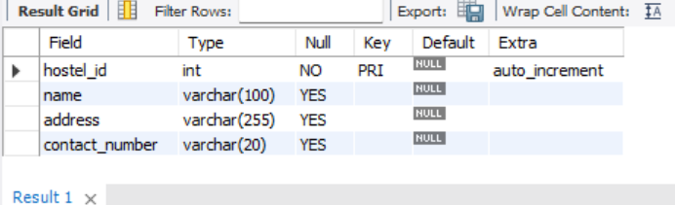
Create database:-
create database hostel;
use hostel;
CREATE TABLES:-
Table1:-
CREATE TABLE hostel (
hostel_id INT PRIMARY KEY AUTO_INCREMENT,
name VARCHAR(100),
address VARCHAR(255),
contact_number VARCHAR(20)
);
Desc hostel;

Slide 7
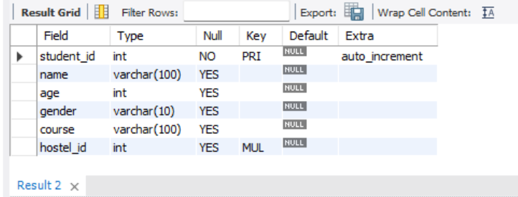
Table2:-
CREATE TABLE students (
student_id INT PRIMARY KEY AUTO_INCREMENT,
name VARCHAR(100),
age INT,
gender VARCHAR(10),
course VARCHAR(100),
hostel_id INT,
FOREIGN KEY (hostel_id) REFERENCES Hostel(hostel_id)
);
Desc students;

Slide 8
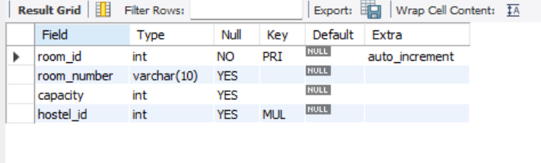
Table3:-
CREATE TABLE rooms (
room_id INT PRIMARY KEY AUTO_INCREMENT,
room_number VARCHAR(10),
capacity INT,
hostel_id INT,
FOREIGN KEY (hostel_id) REFERENCES Hostel(hostel_id)
);
Desc rooms;

Slide 9
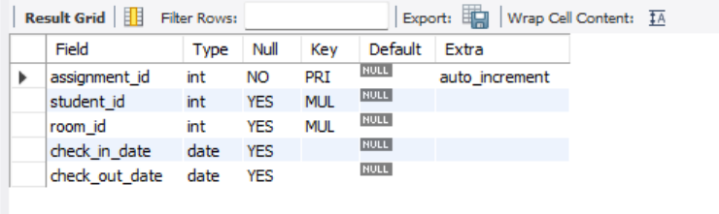
Table4:-
CREATE TABLE roomassignments (
assignment_id INT PRIMARY KEY AUTO_INCREMENT,
student_id INT,
room_id INT,
check_in_date DATE,
check_out_date DATE,
FOREIGN KEY (student_id) REFERENCES Students(student_id),
FOREIGN KEY (room_id) REFERENCES Rooms(room_id)
);
Desc roomassignments;

Slide 10
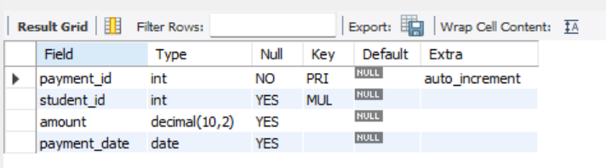
Table5:-
CREATE TABLE Payments (
payment_id INT PRIMARY KEY AUTO_INCREMENT,
student_id INT,
amount DECIMAL(10, 2),
payment_date DATE,
FOREIGN KEY (student_id) REFERENCES Students(student_id)
);
Desc payments;

Slide 11
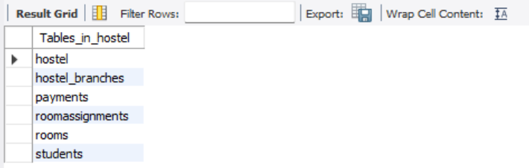
Show tables;

Slide 12
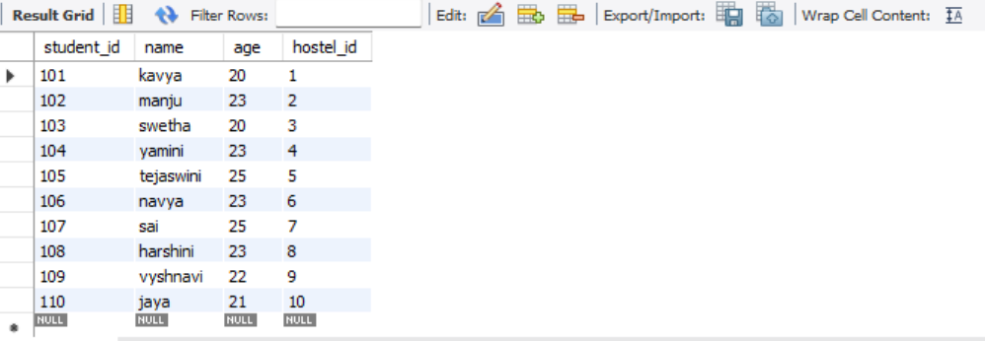
How to Get All Students Living in the Hostel?
select student_id,name,age,hostel_id from students;

Slide 13
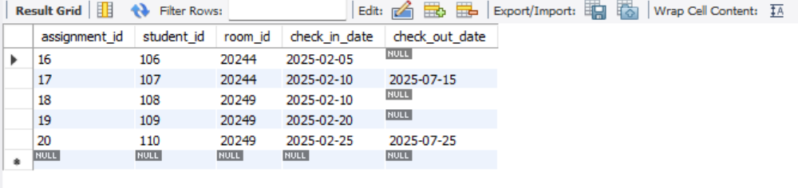
Get a list of students who checked in after February 1, 2025?
SELECT * FROM roomassignments WHERE check_in_date > '2025-02-01';

Slide 14
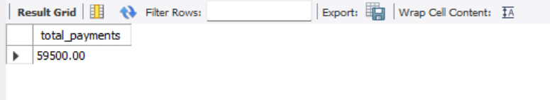
how to get the total payments received by the hostel?
SELECT SUM(amount) AS total_payments
from payments;

Slide 15
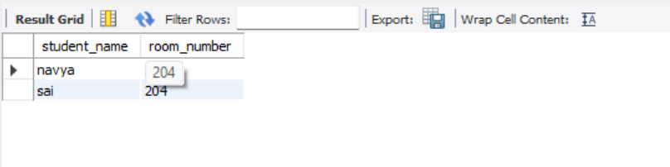
How to get all students in a particular room?
SELECT s.name AS student_name, r.room_number
FROM Students s
JOIN RoomAssignments ra ON s.student_id = ra.student_id
JOIN Rooms r ON ra.room_id = r.room_id
WHERE r.room_number = ‘204';

Slide 16
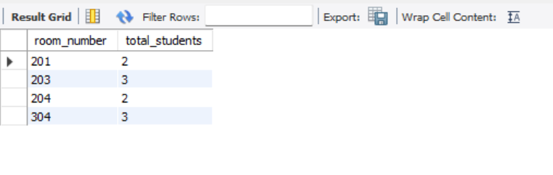
how to get the total number of students in each room?
SELECT r.room_number, COUNT(s.student_id) AS total_students
FROM Rooms r
JOIN RoomAssignments ra ON r.room_id = ra.room_id
JOIN Students s ON ra.student_id = s.student_id
GROUP BY r.room_number;

Slide 17
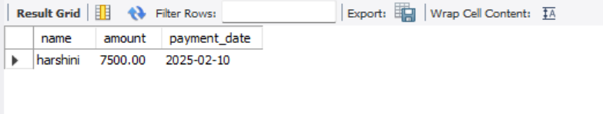
How to get payment details for a particular student?
SELECT name,p.amount, p.payment_date
FROM Payments p
JOIN Students s ON p.student_id = s.student_id
WHERE s.name = ‘harshini';

Slide 18
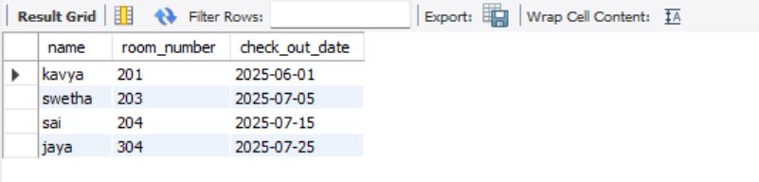
how to get all students who are yet to check out?
SELECT s.name, r.room_number, ra.check_out_date
FROM RoomAssignments ra
JOIN Students s ON ra.student_id = s.student_id
JOIN Rooms r ON ra.room_id = r.room_id
WHERE ra.check_out_date > CURDATE();

Slide 19
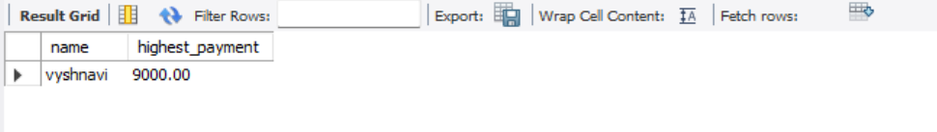
How to get the student who paid the highest amount?
SELECT s.name, MAX(p.amount) AS highest_payment
FROM Payments p
JOIN Students s ON p.student_id = s.student_id
GROUP BY s.name
ORDER BY highest_payment DESC
LIMIT 1;

Slide 20
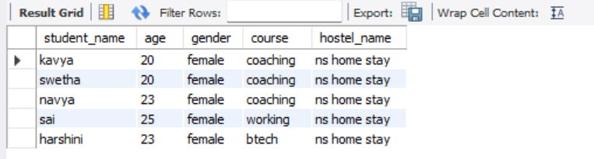
how to get all students staying in a particular hostel?
SELECT s.name AS student_name, s.age, s.gender, s.course, h.name AS hostel_name
FROM Students s
JOIN Hostel h ON s.hostel_id = h.hostel_id
WHERE h.address = 'madhapur';

Slide 21
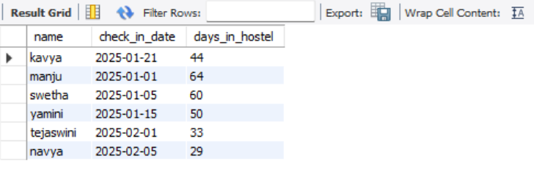
how to get the details of students who have stayed in the hostel for more than a month?
SELECT s.name, ra.check_in_date, DATEDIFF(CURDATE(), ra.check_in_date) AS days_in_hostel
FROM RoomAssignments ra
JOIN Students s ON ra.student_id = s.student_id
WHERE ra.check_in_date <= CURDATE() - INTERVAL 1 month;

Slide 22
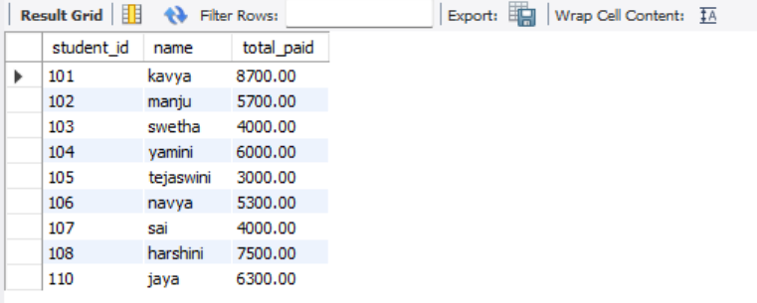
Get All Students with Pending Payments
(Example: Payment due is greater than a certain amount)
SELECT s.student_id, s.name, SUM(p.amount) AS total_paid
FROM Students s
JOIN Payments p ON s.student_id = p.student_id
GROUP BY s.student_id
HAVING SUM(p.amount) < 9000;

Slide 23
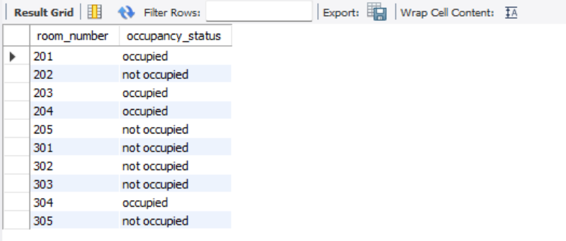
How to get which rooms are occupied and which are not?
select t2.room_number,IF(t1.student_id IS NULL, ‘not occupied', 'occupied') AS occupancy_status
from rooms t2
left join roomassignments t1 on t1.room_id=t2.room_id
group by t2.room_number,occupancy_status;

Slide 24
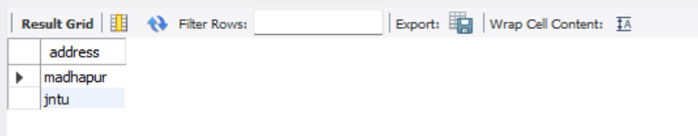
View how many branches in hostel?
create view hostel_branches as select distinct address from hostel;
select * from hostel_branches;

Slide 25
Conclusion:
The Girls' Hostel Management System ensures an organized,
automated, and error-free process of managing hostel records.
By implementing SQL-based database management, hostel
administrators can efficiently track students, monitor fees,
and ensure overall operational efficiency.

Slide 26
Final note:-
The Final note for a Hostel Management System in SQL is about
ensuring efficient data storage, retrieval, and maintaining data
integrity while focusing on the relationship between entities such
as hostel , students, rooms, room assignments and payments.

Slide 27
Thank you.

